Slide 1
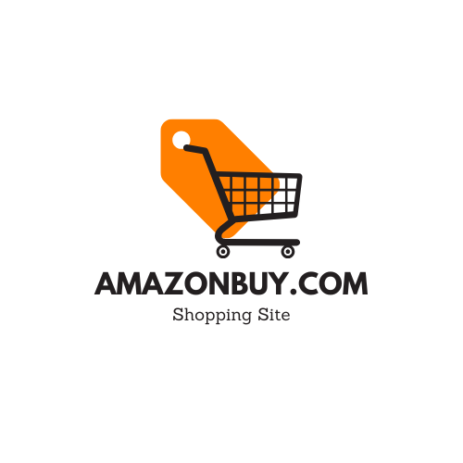
Presenter :- Shubham Y. Jadhav
My Brand Website Link :- http://amazonbuy.unaux.com/sj16/

Slide 2
01
Brand Introduction
11
Funnel Creation
02
Competitor Research
12
Paid Marketing Strategy
03
SWOT Analysis
13
Engagement Strategies
04
Brand Identity
14
Digital Marketing & AI Tools
05
Social Media Setup
Contents
06
Website Development
07
Organic Marketing
08
Content Optimization
09
On-Page SEO
10
Off-Page SEO

Slide 3
Brand Introduction
Unique Selling Points (USP)
Services
1. Global Reach with Local Expertise:
amazonbuy.unaux.com connects buyers and sellers across country.
2. Transparent Pricing:
No hidden fees - customers receive clear, upfront shipping costs.
3. Fast & Reliable Delivery:
Optimized logistics routes and trusted carrier partnerships ensure timely deliveries.
4. Smart Tracking Technology:
Real-time tracking provides full visibility from dispatch to final delivery.
5. E-commerce Friendly Solutions:
Designed to scale with online businesses.
6. Customer-Centric Support:
Dedicated assistance ensures quick resolution of shipping inquiries.
Shipping Services:
shipping solutions
Door-to-door delivery
Logistics & Fulfilment:
Warehousing and inventory storage
Customs clearance assistance
E-commerce Support:
Order tracking and management
Returns handling
Customer Tools:
Real-time shipment tracking
Cost estimation and shipping calculators
Brief History of the Brand
amazonbuy.unaux.com was founded with a clear vision to simplify global online shopping and shipping. Established as a digital logistics and e-commerce support platform, the brand emerged to bridge the gap between buyers and reliable, fast shipping solutions. Over time, amazonbuy.unaux.com evolved into a trusted shipping partner for individuals, small businesses, and online retailers seeking efficient cross-border delivery.
Mission Statement
Our mission is to make global shopping and shipping fast, transparent, and accessible for everyone by combining smart logistics, competitive pricing, and customer-centric service.
1
2
3
4

Slide 4


Four Major Competitors Research
Competitor | Website | Instagram | Facebook | Twitter/X | Linkedin | YouTube
Walmart
Alibaba
eBay
Flipkart

Slide 5
SWOT Analysis
Strengths
Unmatched product variety and global scale
Industry-leading logistics and fulfillment network
Strong brand recognition and customer trust
Advanced technology, AI, and data analytics
Weaknesses
Thin profit margins in retail operations
Quality control issues with third-party sellers
Counterfeit products and fake reviews
Complex marketplace experience for new users
Opportunities
Expansion into emerging markets
Growth in sustainable and eco-friendly logistics
Improved seller verification and marketplace trust
Enhanced private labels and exclusive brands
Threats
Intense competition from Walmart, Alibaba, eBay, and Flipkart
Increasing regulatory and antitrust scrutiny
Rising labor, fuel, and fulfillment costs
Price wars and margin pressure

Slide 6
Compare with competitor research
Comparison | Amazonbuy Strength | Competitor Strength
Amazonbuy vs Walmart | Leads in logistics speed and fast delivery | Offers lower prices and allows customers to shop both online and in physical stores.
Amazonbuy vs Flipkart | Global e-commerce leader with strong international presence | Market leader in India with deep local market penetration
Amazonbuy vs eBay | Dominates mass retail and everyday purchases | Strong community for auctions, collectibles, and second-hand items.
Amazonbuy vs Alibaba | Higher consumer trust in Western markets | Leads in global sourcing and international B2B trade

Slide 7
Chosen Brand Colours
1. Black
Reliable, High-quality, Self-assured
2. Orange
Energy, Innovation, Creative
3. White
Clarity, Simplicity, Transparency
Why it was chosen :-
Black gives the brand a strong base. It makes the brand feel serious and trustworthy, and it helps other colors. Instead of copying luxury or tech brands, black is used to show reliability and focus, not exclusiveness.
Why it was chosen :- Orange adds personality and energy. It makes the brand feel more friendly and alive, not cold or distant. Instead of using common blue or red like many competitors, orange helps the brand feel bold, active, and confident in standing out.
Why it was chosen :- White gives the design space to breathe. It makes the brand feel clean, modern, and easy to use. White also shows honesty and simplicity, which helps the brand stand out from competitors with busy or messy designs.

Slide 8
Brand Tagline :-
“Everything You Need, One Click Away.”
Meaning :- Offers many types of products, brands, and price ranges, making it a one-stop shop for daily needs and special purchases. Focuses on easy use, fast shopping, quick checkout, and reliable delivery to save customers time and effort.
Connection to the brand identity :-
Customer obsession: Making shopping simpler, faster, and more intuitive.
Convenience at scale: From search to checkout to delivery, the experience is designed to reduce friction.
Trust and reliability: Customers feel confident they can find what they need and receive it quickly.
Modern, tech-driven retail: The “one click” concept reflects innovation, smart systems, and digital efficiency

Slide 9
How the Website Is Useful for the Brand :-
The website acts as the main digital storefront, showcasing products, deals, and categories in one place.
It strengthens brand identity through consistent layout, colors, and product presentation.
Promotional sections (Best Sellers, Holiday Deals, New Arrivals) help drive sales and conversions.
The structured homepage allows the brand to highlight priority products and campaigns easily.
It builds credibility and trust by presenting the brand as professional and well-organized.
How the Website Is Useful for the Audience :-
Users can quickly find products through clear categories and featured sections.
Deal-focused sections help customers save time and money.
Clean layout and visuals make browsing easy and enjoyable.
Product groupings (Books, Electronics, Fashion, Home) support simple decision-making.
Seasonal and trending sections keep users engaged and coming back.

Slide 10
Social Media Setup
The Profile Links :-
Facebook :- https://www.facebook.com/profile.php?id=61585328716482
Instagram :- https://www.instagram.com/amazonbuy_16/
LinkedIn :- https://www.linkedin.com/company/amazonbuy/?viewAsMember=true
YouTube :- https://www.youtube.com/@amazonbuy16
X/twitter :- https://x.com/sar007tk

Slide 11
Organic Marketing
Behind the Brand
Daily Tips / Hacks
Product Benefits Explained
Product Comparison
10 Relevant Content Topics
How to Use the Product
Limited-Time Offer
Before & After Results
Top 3 Mistakes Customers Make
Customer Reviews
FAQs Answered

Slide 12
Content Calendar
Date | Platform | Content Topic | Content Type | Caption Idea | CTA | Links
Day 1 | Instagram | Brand Introduction | Reel | Meet the brand built for quality & trust | Follow Us | Instagram
Day 2 | Facebook | Product Benefits | Reel | Here’s why customers love this product | Learn More | Facebook
Day 3 | YouTube | How-To Tutorial | Short Video | How to use it in 30 seconds | Save Post | YouTube
Day 4 | Twitter/X | Customer Review | Image | Real feedback from real customers | Shop Now | Twitter/X
Day 5 | LinkedIn | Before & After | Reel | See the difference yourself | Try Today | LinkedIn
Day 6 | Instagram | Tips & Hacks | Short Video | 3 tips you should know | Share This | Instagram
Day 7 | Facebook | FAQ | Image | Answering your most common question | DM Us | Facebook
Day 8 | Instagram | Comparison | Reel | Why we stand out from the rest | Choose Better | Instagram
Day 9 | Facebook | Offer | Reel | Limited-time deal available | Buy Now | Facebook
Day 10 | Instagram | Brand Trust | Image | Quality, trust & fast delivery | Follow for More | Instagram

Slide 13
Content Optimization
1. How to Choose the Right Product Online: A Buyer’s Guide (2025)
High search intent, evergreen content
2. Top 7 Mistakes People Make When Shopping Online (And How to Avoid Them)
Educational + trust-building
3. Why Quality Matters More Than Price in Online Shopping
Brand authority & conversion-focused
4. How Customer Reviews Influence Buying Decisions
SEO + social proof
5. Top Trends in Online Shopping You Should Know This Year
Trending + shareable content

Slide 14
Content Optimization
Week | Publish Date | Blog Title | Keyword Focus | Content Goal | Links
Week 1 | Day 1 | How to Choose the Right Product Online | Online shopping guide | Educate buyers | WordPress
Week 1 | Day 3 | Top 7 Online Shopping Mistakes | Online shopping mistakes | Awareness | Blogger
Week 2 | Day 1 | Why Quality Matters More Than Price | Product quality importance | Brand trust | Medium
Week 2 | Day 3 | How Reviews Influence Buying Decisions | Customer reviews impact | Social proof | Tumblr
Week 3 | Day 1 | Online Shopping Trends for 2025 | Online shopping trends | Traffic growth | LinkedIn

Slide 15
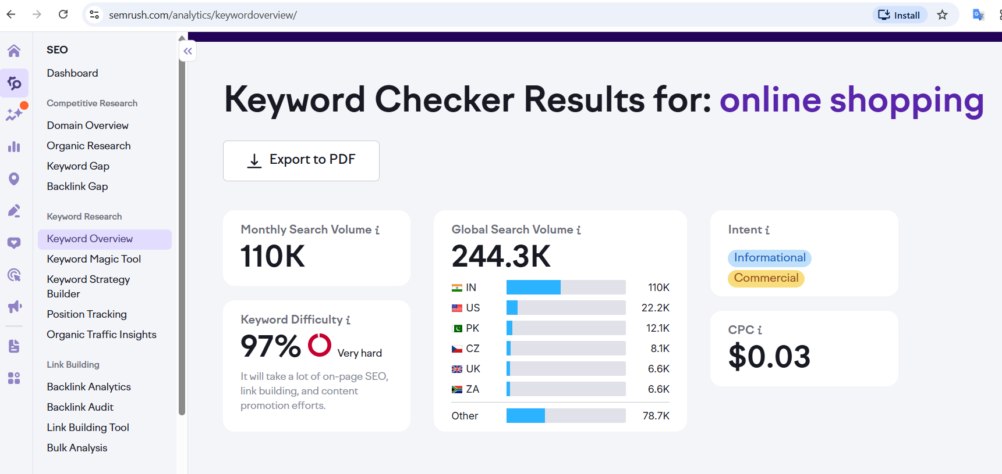
On-Page SEO
Five relevant keywords :-
Keyword | Avg. Monthly Search Volume | Competition | Reason for Selection
Online shopping | 55,000 | Medium | High purchase intent and focused users
Ecommerce website | 55,000 | Low | Strong branding and comparison searches
Groceries online | 5,000 | Medium | Core transactional keyword
Instant delivery | 5,000 | Medium | Targets price-sensitive customers
Buy electronics | 500 | High | Trend-based keyword

Slide 16
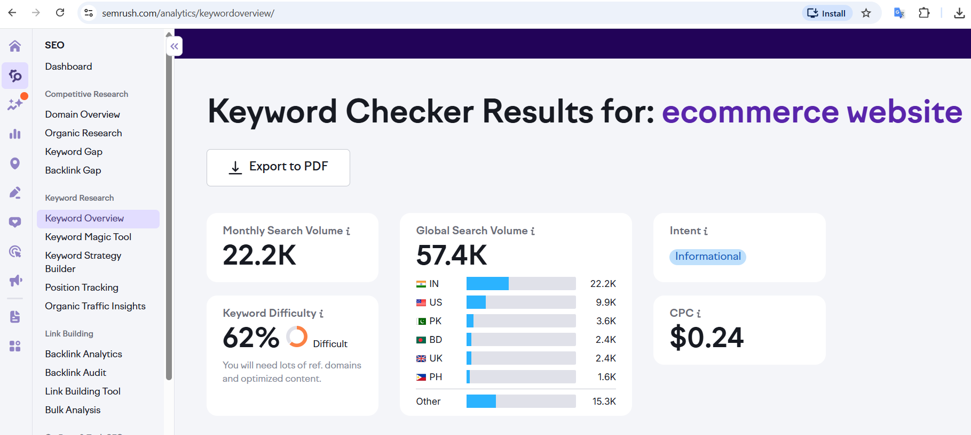

Slide 17
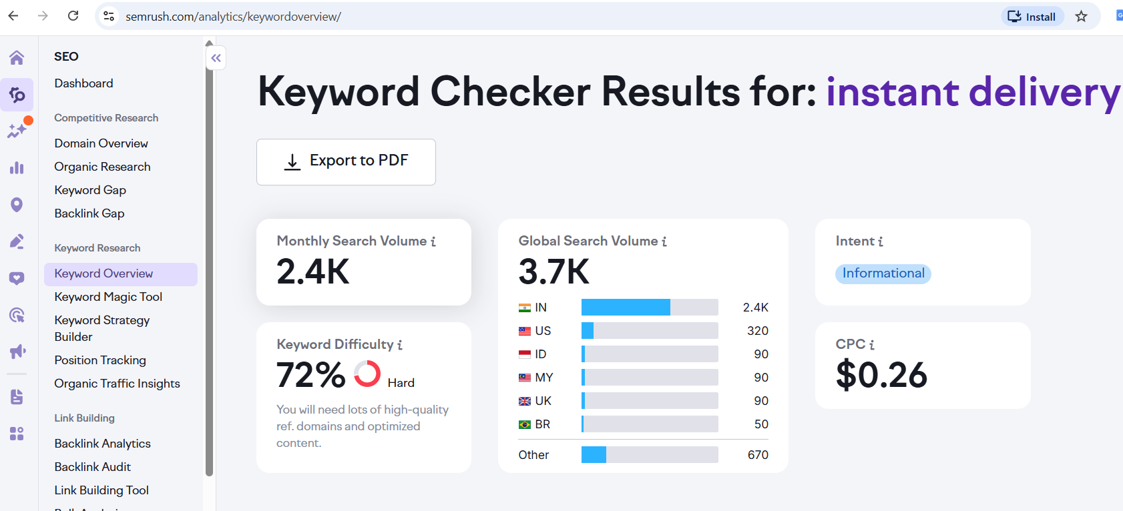

Slide 18
Off-Page SEO
25 backlinks for my website :-
Analyze the Domain Authority (DA), Spam Score and Monthly Traffic of each website
Document backlinks in my Google Sheet and provide the link below :-
https://docs.google.com/spreadsheets/d/1oKKCSHc2ZimkrZXuPVrbbu5mOI_gRijf-YZiJ6TyKNY/edit?usp=sharing

Slide 19
Funnel Creation
Awareness
Interest
Action
Desire
Social Media Ads →
YouTube / Display Ads →
Brand Introduction →
{Audience: New Users}
→ Product Posts
→ How-To Videos
→ Blog Content
{Audience: Visitors}
Reviews →
Comparisons →
Offers →
{Audience: Leads}
→ Buy Now
→ Retarget
{Audience: Customers}

Slide 20
Paid Marketing Strategy (on AIDA Funnel)
The Total Marketing Budget is ₹1,18,000 (1,00,000 + 18% GST)
Budget Allocation :-
Facebook & Instagram Ads - ₹30,000
Google Ads - ₹50,000
LinkedIn Ads - ₹20,000
Awareness Stage
Platforms Used
Facebook & Instagram
Google Ads
Budget Allocation
FB & Instagram: ₹17,700 (15,000 + 18% GST)
Google Ads: ₹17,700 (15,000 + 18% GST)

Slide 21
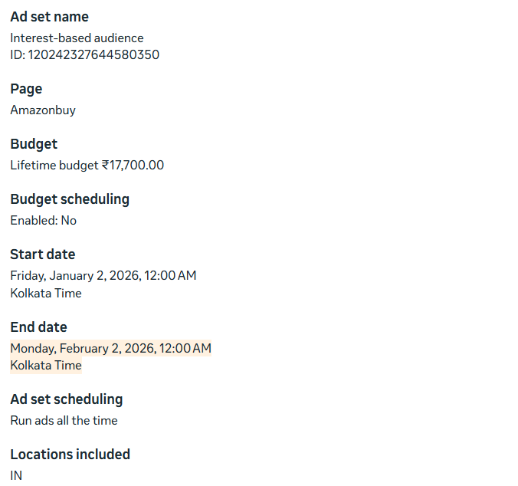
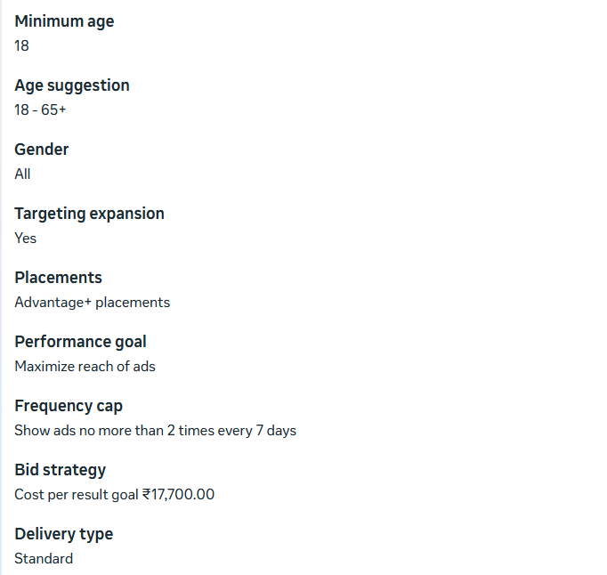
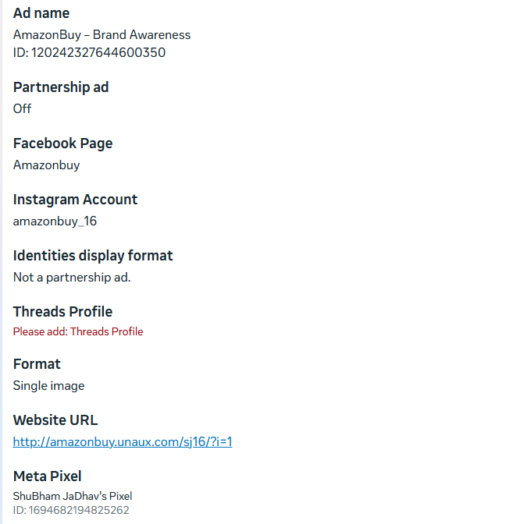
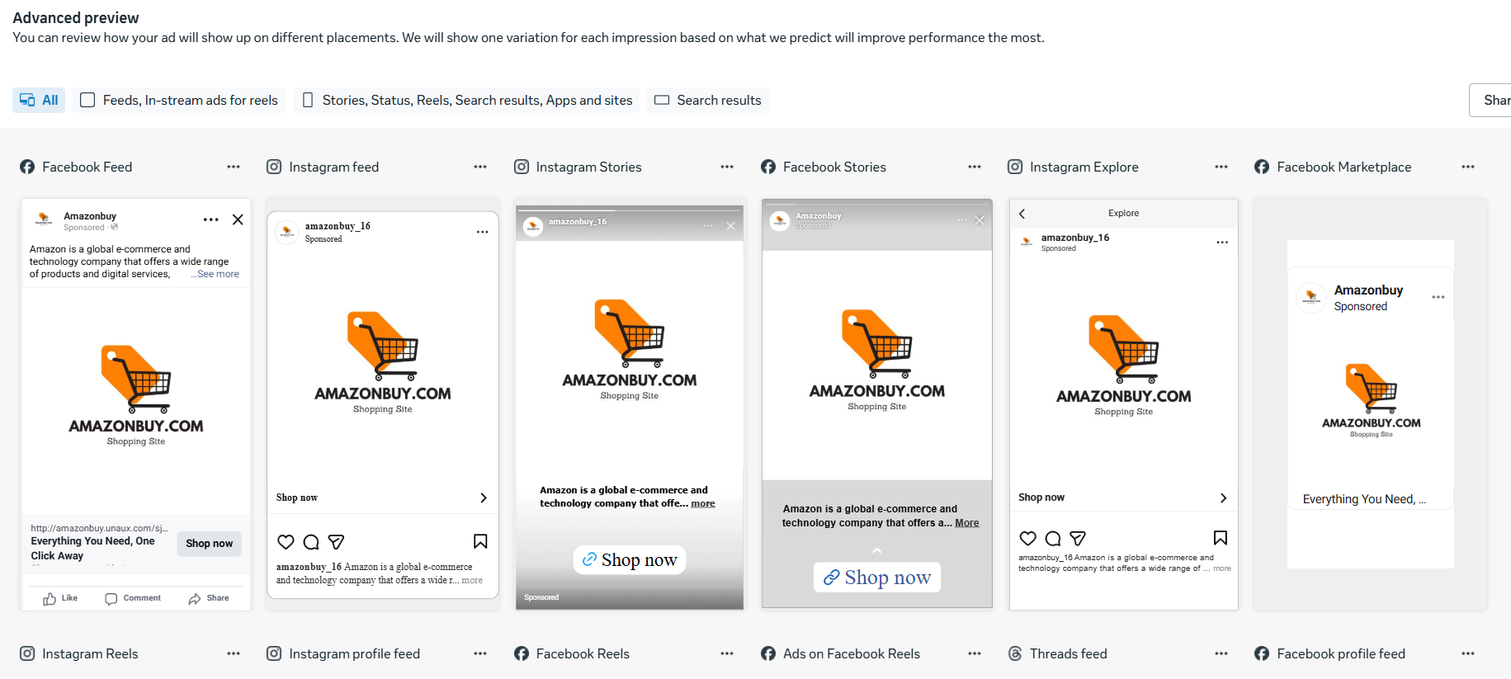
FB & Instagram Campaign Screenshots

Slide 22
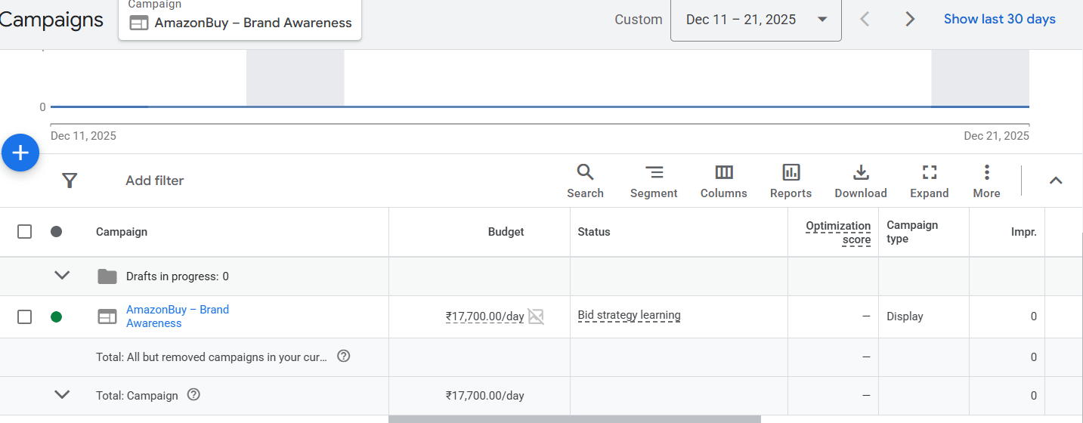
Paid Marketing Strategy
Google Ads Campaign Screenshots

Slide 23
Paid Marketing Strategy (on AIDA Funnel)
The Total Marketing Budget is ₹1,18,000 (1,00,000 + 18% GST)
Budget Allocation :-
Facebook & Instagram Ads - ₹30,000
Google Ads - ₹50,000
LinkedIn Ads - ₹20,000
2. Interest Stage
Platforms Used
Facebook & Instagram
Google Ads
Budget Allocation
FB & Instagram: ₹11,800 (10,000 + 18% GST)
Google Ads: ₹23,600 (20,000 + 18% GST)

Slide 24
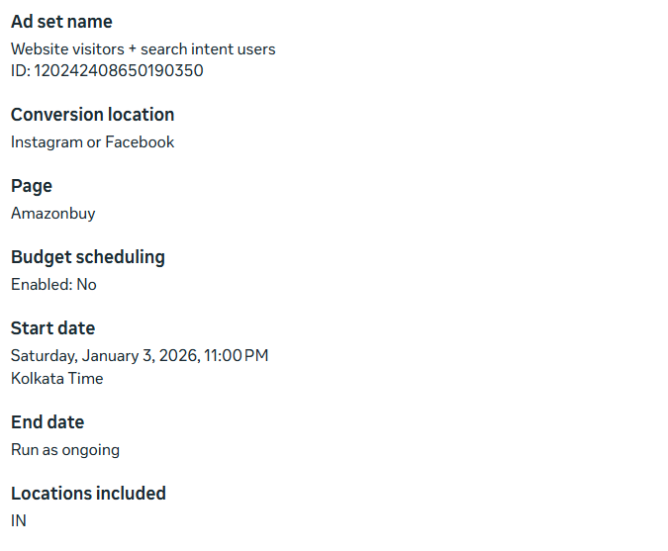
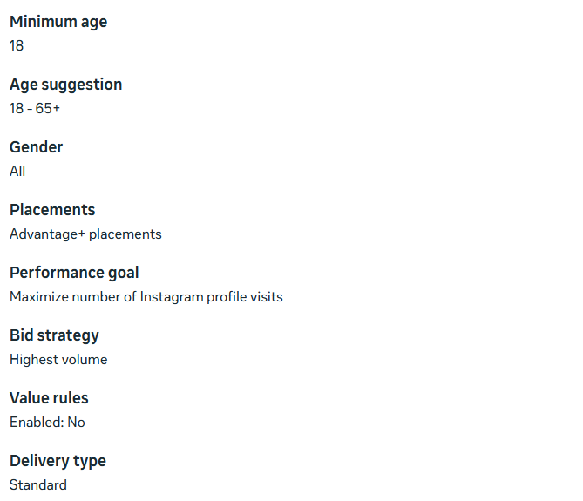
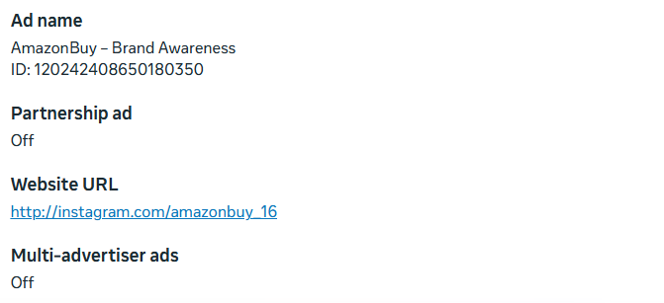
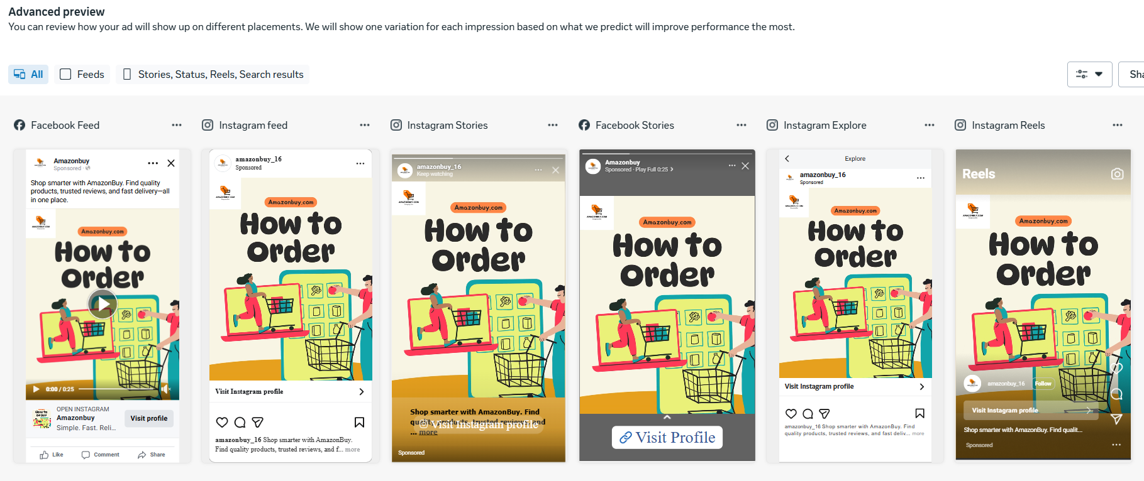
FB & Instagram Campaign Screenshots

Slide 25
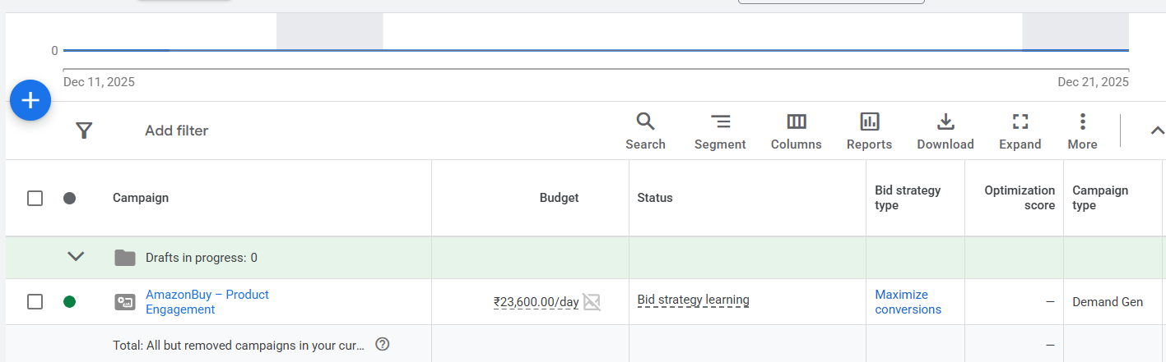
Paid Marketing Strategy
Google Ads Campaign Screenshots

Slide 26
Paid Marketing Strategy (on AIDA Funnel)
The Total Marketing Budget is ₹1,18,000 (1,00,000 + 18% GST)
Budget Allocation :-
Facebook & Instagram Ads - ₹30,000
Google Ads - ₹50,000
LinkedIn Ads - ₹20,000
3. Desire Stage
Platforms Used
LinkedIn Ads
Google Ads
Budget Allocation
LinkedIn Ads: ₹11,800 (10,000 + 18% GST)
Google Ads: ₹11,800 (10,000 + 18% GST)

Slide 27
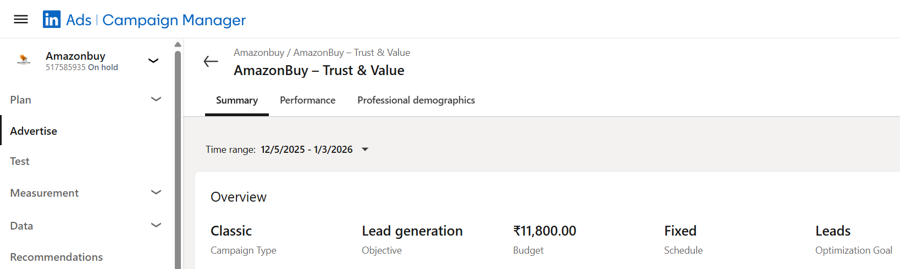
LinkedIn Ads Campaign Screenshots

Slide 28
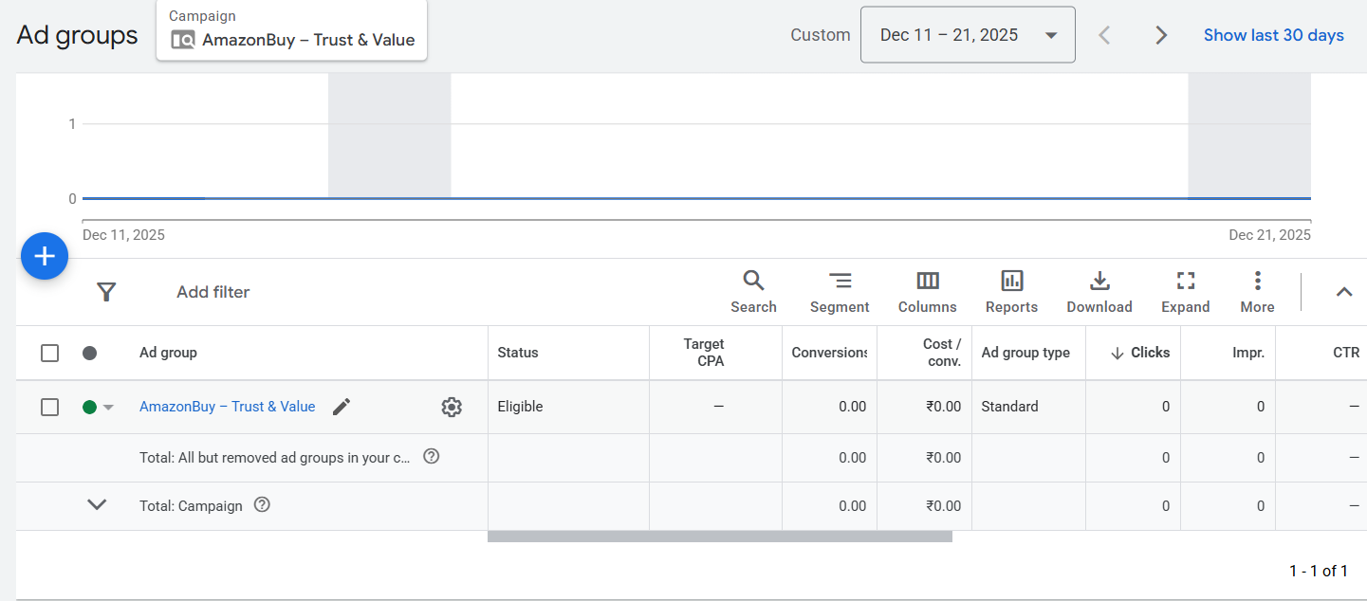
Paid Marketing Strategy
Google Ads Campaign Screenshots

Slide 29
Paid Marketing Strategy (on AIDA Funnel)
The Total Marketing Budget is ₹1,18,000 (1,00,000 + 18% GST)
Budget Allocation :-
Facebook & Instagram Ads - ₹30,000
Google Ads - ₹50,000
LinkedIn Ads - ₹20,000
4. Action Stage
Platforms Used
Google Ads
Facebook & Instagram
Budget Allocation
Facebook & Instagram: ₹11,800 (10,000 + 18% GST)
Google Ads: ₹11,800 (10,000 + 18% GST)

Slide 30
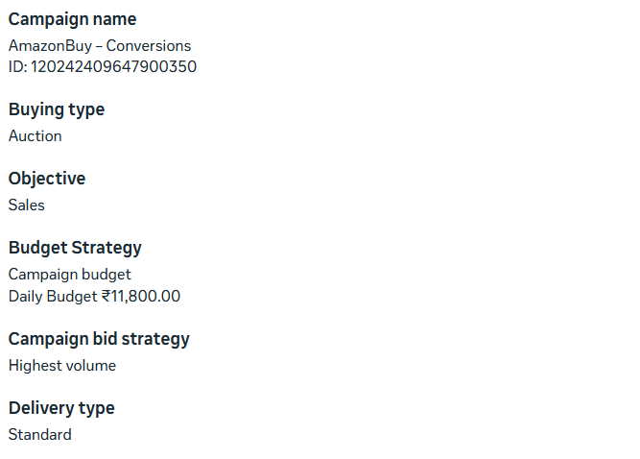
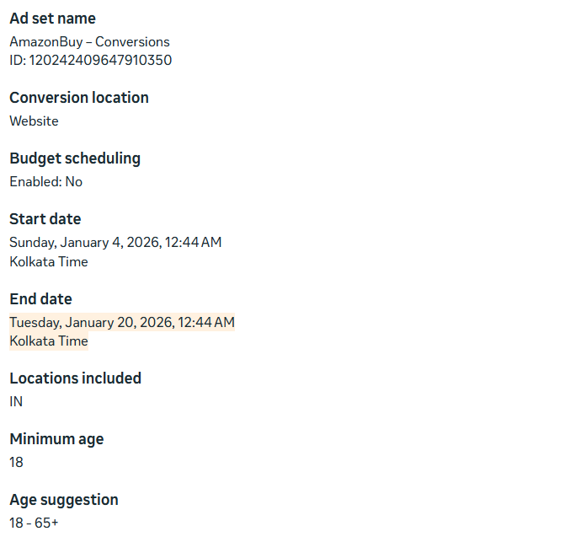
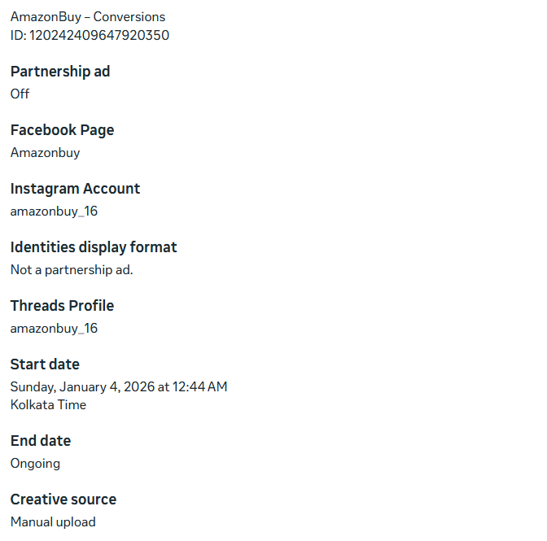
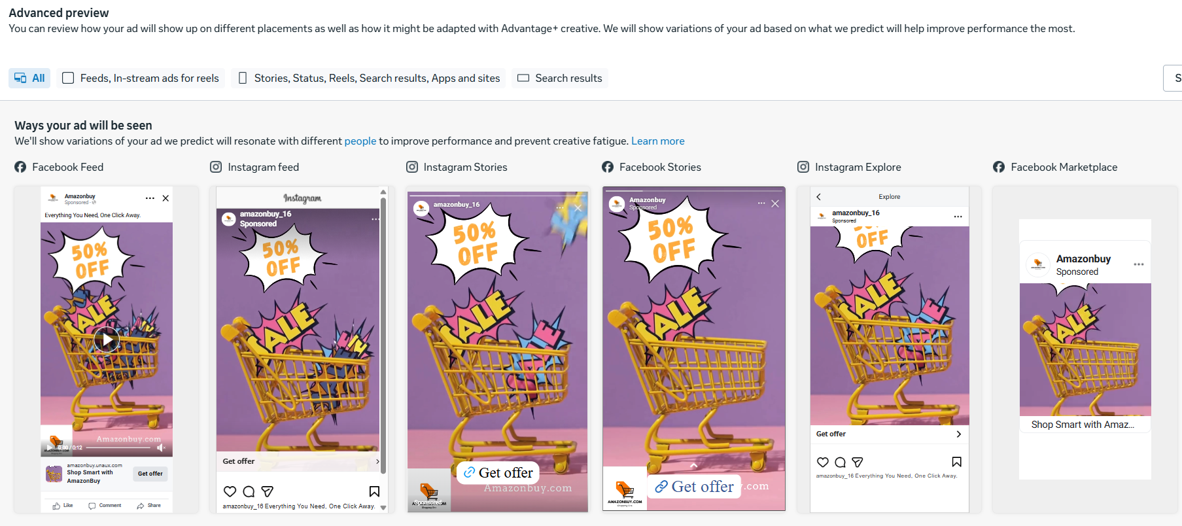
FB & Instagram Campaign Screenshots

Slide 31
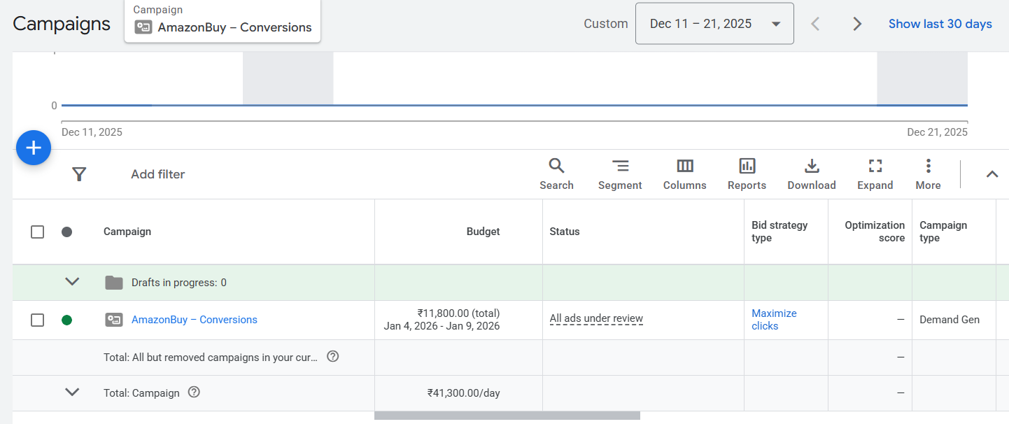
Paid Marketing Strategy
Google Ads Campaign Screenshots

Slide 32
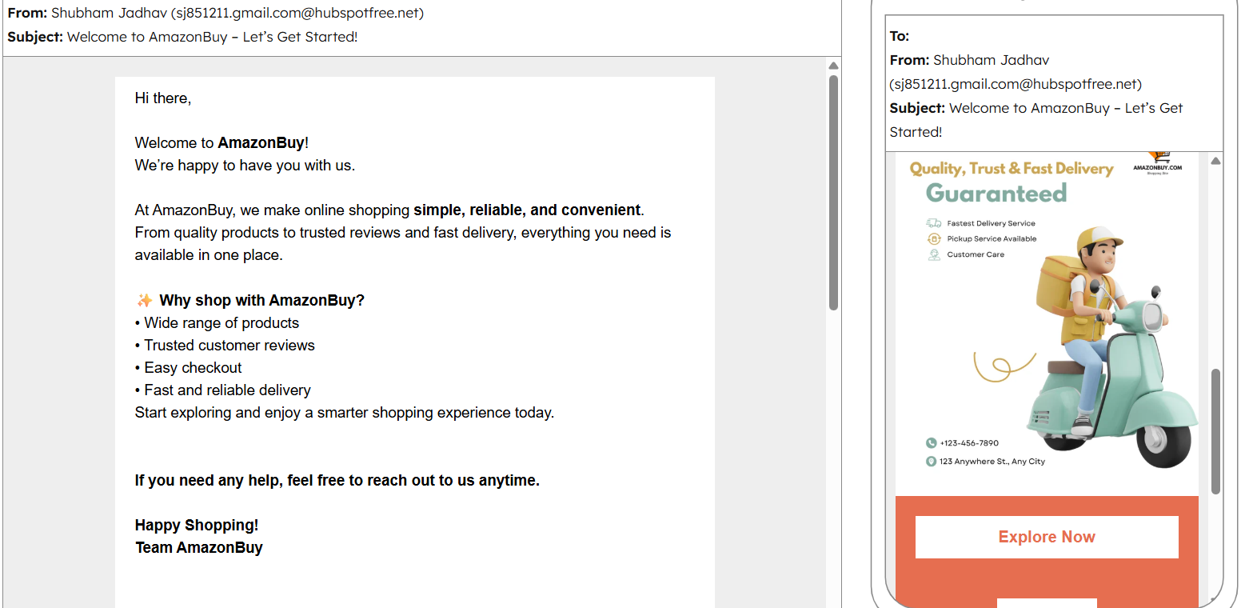
Engagement Strategies
Week 1 – Welcome & Brand Introduction
Goal: Build connection with new users

Slide 33
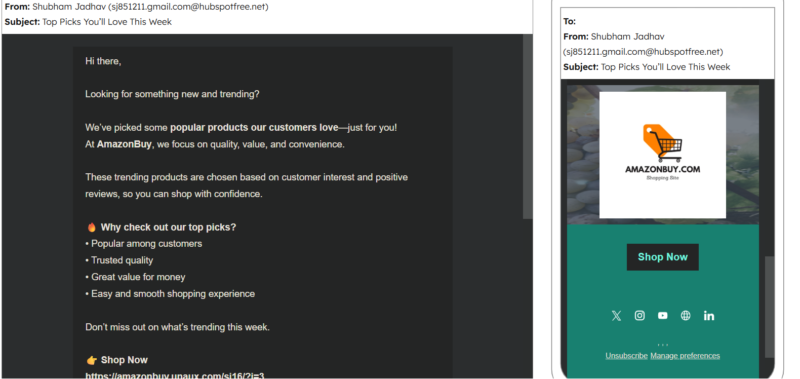
Engagement Strategies
Week 2 – Product Highlights
Goal: Increase engagement & browsing

Slide 34
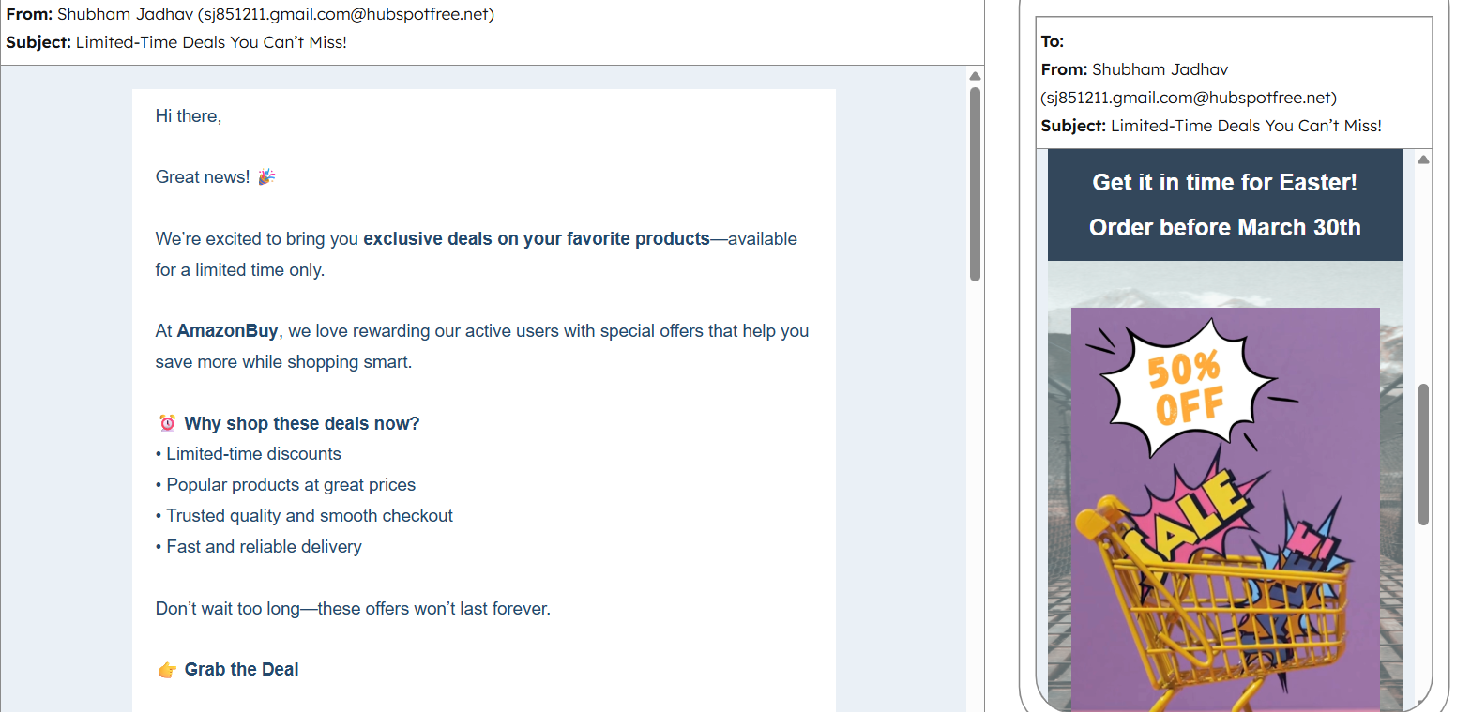
Engagement Strategies
Week 3 – Offers & Discounts
Goal: Drive sales

Slide 35
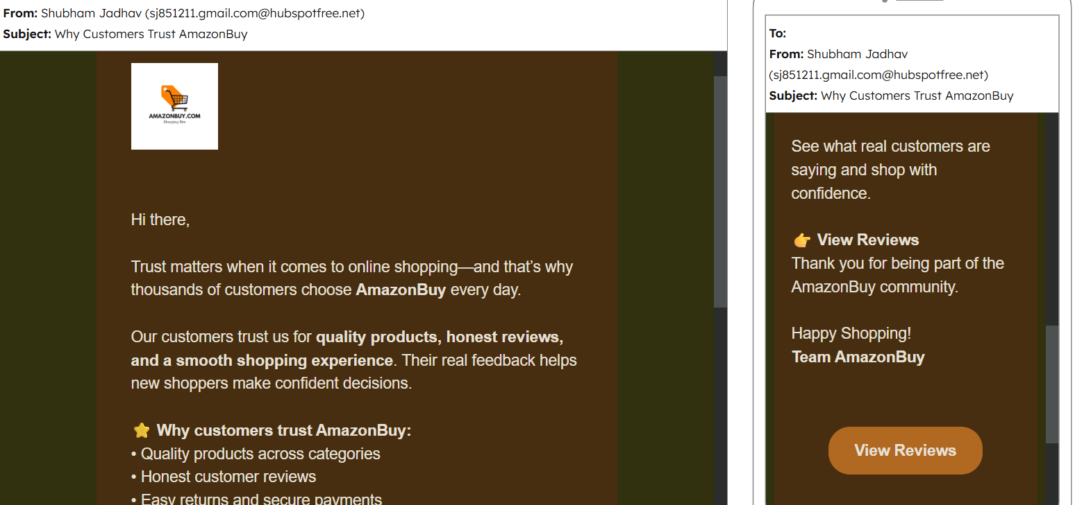
Engagement Strategies
Week 4 – Trust & Reviews
Goal: Build trust & repeat purchase

Slide 36
Digital Marketing & AI Tools
Canva :- Brand Logo, Social Media Setup (Reels, Videos, Images)
Hubspot.com :- Email Campaigns
Profreehost.com :- Develop a one-page website (free domain)
SEMrush.com :- On-Page SEO strategies
Chatgpt.com :- Prompt Engineer, QuillBot AI - Paraphrasing Tool, DALL·E
ads.google.com :- Goggle ads Campaign
analytics.google.com :- Research keywords
Meta ads manager :- Facebook ads, Instagram ads & Whatapp ads
Linkedin Campaign Manager :- Linkedin ads
Backlinks :- backlinko.com, moz.com, seoreviewtools.com, dapachecker.org, majestic.com, ahrefs.com, websiteseochecker.com

Slide 37
thanks!

